Slide 1
JSE TECHNOLOGY REFRESH
SENS ROADMAP REVIEW
12 June 2019

Slide 2
Agenda
  Reason for SENS review
  High Level overview of current SENS data products
  Background
  JSE Proposed Idea 1
  JSE Proposed Idea 2
  JSE Proposed Idea 3
  How can clients help?
  Next steps
  End – Thank You

Slide 3

Reason for SENS review
Strategy alignment and key drivers for change
Continuous alignment, where feasible, to international best practice and standards
Cater for changes to the way that Listed Companies or their Sponsors want to provide information to JSE
Adapt to evolving SENS data distributor and consumer needs
The overall ambition is to provide as much structured data as possible to assist users with analysis needs

Slide 4

High level overview of current SENS data products
Live SENS
Non-Live SENS
SENS stories are disseminated intraday via the live SENS market data feed to all licensed Live SENS data subscribers as soon as they are released for publication
All SENS stories published during the day are made available at the end of day to licensed non-live SENS data subscribers via two End of Day SENS market data files via JSE IDP FTP server
Live SENS data provided in NEWSML format via special Fix/Fast messages
End of day SENS data is provided in NewsML format in Text and PDF modes

Slide 5
JSE Proposed ideas – Idea 1
  Introduce Structured Data as part of SENS announcement dissemination.
The idea:
Allow Sponsors to capture context specific to each SENS announcement via front end fields and include these fields as part of the NewsML for dissemination.
The benefit:
  Allow for machine processing of announcements.
Example:
Interest Rate Reset on Debt Instrument. Can include the coupon rate and payment date.
Director dealings, content could include Director Name, Buy or Sell and the number of shares at a specific price. (To be determined).
  Note that this idea 1 will be in combination with Ideas 2 and 3

Slide 6
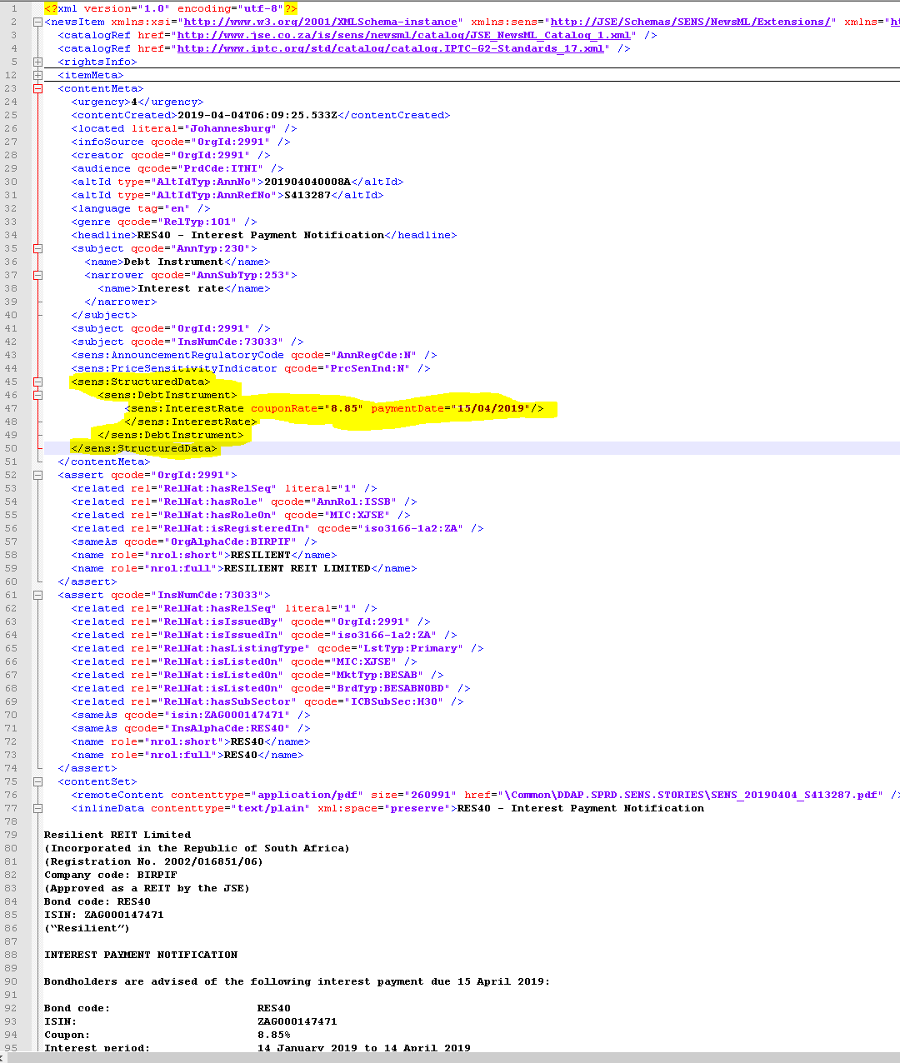
JSE Proposed ideas – Idea 1 Example

Slide 7
JSE Proposed ideas – Idea 2
  Move away from 2 documents(TEXT and PDF) to a single dissemination format of XHTML.
The idea:
Allow the sponsors to upload announcements in XHTML format and disseminate within the NewsML structure via the News Gateway.
The benefit:
  Single upload format
  Single dissemination format
  No additional download for the media quality version of the announcement (currently the PDF versions).
  Note that this idea will be in combination with Ideas 1 and 3. But idea 2 could also be done as a standalone change

Slide 8
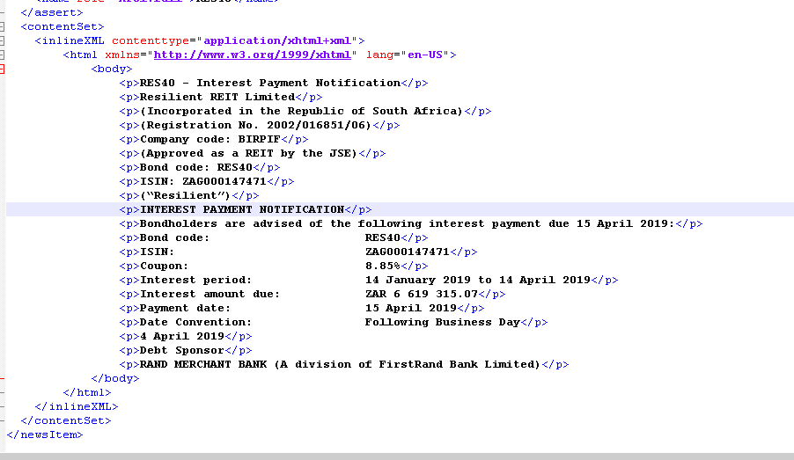
JSE Proposed ideas – Idea 2 Example

Slide 9
JSE Proposed ideas – Idea 3
  Disseminate Financial Results as iXBRL.
The idea:
iXBRL, or Inline XBRL, is an open standard that enables a single document to provide both human-readable and structured, machine-readable data.
Disseminate Financial Results within the NewsML structure via the News Gateway.
Dependant on proposed idea to move to XHTML.
The benefit:
  Single document for dissemination.
  Allow for machine processing of financial results.
  Distribution of Financial Results for analysis from a single source.
  Note that this idea 3 will be in combination with Ideas 1 and 2

Slide 10

How can clients help?
  Details of the structured data and the taxonomy upfront of the final changes.
  Review the ideas that the JSE proposes and provide feedback.
  But also tell us what we should consider as system constraints, blockers, enhancements.
  Both business and technical perspectives will be ideal as each will have different needs and pain points.
  Your feedback is important to us to arrive at the best possible design
  The JSE will consider all suggestions but might not be able to accommodate all of them. Where not, the JSE will provide reasons

Slide 11

Next Steps
  2. Assess the ideas that JSE is proposing and think of any other aspects (potential enhancements, pain points) that the JSE should consider in the design.
  Feel free to include input from your clients where it pertains to the data that the JSE provides
  1. A feedback form has been provided for your convenience
  3. Provide the feedback to the JSE by completing and returning the feedback form to the JSE to mdprojects@jse.co.za.
  The completed form must be provided by COB on 28 June 2019.
  4. The JSE will consider all submissions in making the final design decisions
  5. The JSE will communicate relevant points back to clients that provide input.
  6. The JSE will formally announce the final changes to all clients by means of the standard JSE notice process.

